Slide 1

4
The Market Forces of Supply and Demand
P R I N C I P L E S O F
F O U R T H E D I T I O N
Notes:
This is perhaps the most important chapter in the textbook. It’s worth mentioning to your students that investing extra time to master this chapter will make it easier for them to learn much of the subsequent material in the book.
This is also one of the longest chapters in the textbook, and this PowerPoint file is one of the most graphically intensive. Many students taking economics for the first time have difficulty grasping the graphs, which are critically important in this and all subsequent chapters in the book. So an extra degree of hand-holding might be appropriate.
Accordingly, this PowerPoint has carefully detailed animations that build many of the graphs with great care. For example, we show a demand or supply schedule next to the axes, and highlight each coordinate pair in the table as the corresponding point appears on the graph.
Please be assured that the presentation of graphs is more streamlined in subsequent chapters. In this early chapter, though, we do not want to leave any students behind.
If your students are already very comfortable with scatter-type graphs, you may wish to simplify or turn off the animation on these slides, in order to get through them faster.

Slide 2
In this chapter, look for the answers to these questions:
What factors affect buyers’ demand for goods?
What factors affect sellers’ supply of goods?
How do supply and demand determine the price of a good and the quantity sold?
How do changes in the factors that affect demand or supply affect the market price and quantity of a good?
How do markets allocate resources?
CHAPTER 4 THE MARKET FORCES OF SUPPLY AND DEMAND

Slide 3
Markets and Competition
0
A market is a group of buyers and sellers of a particular product.
A competitive market is one with many buyers and sellers, each has a negligible effect on price.
A perfectly competitive market:
  all goods exactly the same
  buyers & sellers so numerous that no one can affect market price – each is a “price taker”
In this chapter, we assume markets are perfectly competitive.
CHAPTER 4 THE MARKET FORCES OF SUPPLY AND DEMAND
Notes:
In the real world, there are relatively few perfectly competitive markets. Most goods come in lots of different varieties – including ice cream, the example in the textbook. And there are many markets in which the number of firms is small enough that some of them have the ability to affect the market price. For now, though, we look at supply and demand in perfectly competitive markets, for two reasons: First, it’s easier to learn. Understanding perfectly competitive markets makes it a lot easier to learn the more realistic but complicated analysis of imperfectly competitive markets. Second, despite the lack of realism, the perfectly competitive model can teach us a LOT about how the world works, as we will see many times in the chapters that follow.

Slide 4
Demand
0
Demand comes from the behavior of buyers.
The quantity demanded of any good is the amount of the good that buyers are willing and able to purchase.
Law of demand: the claim that the quantity demanded of a good falls when the price of the good rises, other things equal
CHAPTER 4 THE MARKET FORCES OF SUPPLY AND DEMAND

Slide 5
The Demand Schedule
0
Price of lattes | Quantity of lattes demanded
$0.00 | 16
1.00 | 14
2.00 | 12
3.00 | 10
4.00 | 8
5.00 | 6
6.00 | 4
Demand schedule:
A table that shows the relationship between the price of a good and the quantity demanded.
Example:
Helen’s demand for lattes.
Notice that Helen’s preferences obey the
Law of Demand.
CHAPTER 4 THE MARKET FORCES OF SUPPLY AND DEMAND

Slide 6
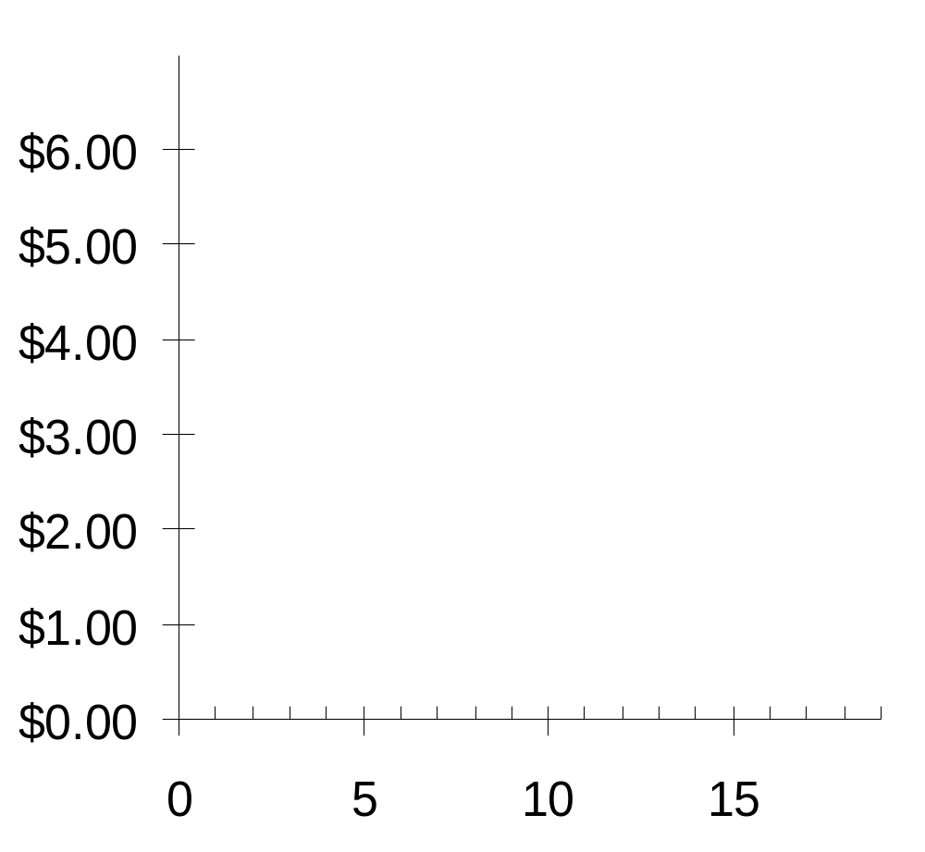
Helen’s Demand Schedule & Curve
0
Price of Lattes
Price of lattes | Quantity of lattes demanded
$0.00 | 16
1.00 | 14
2.00 | 12
3.00 | 10
4.00 | 8
5.00 | 6
6.00 | 4
Quantity of Lattes
CHAPTER 4 THE MARKET FORCES OF SUPPLY AND DEMAND

Slide 7
Market Demand versus Individual Demand
0
The quantity demanded in the market is the sum of the quantities demanded by all buyers at each price.
Suppose Helen and Ken are the only two buyers in the Latte market. (Q^{d} = quantity demanded)
Price
Helen’s Q^{d}
Ken’s Q^{d}
Market Q^{d}
$0.00
16
+
8
=
24
1.00
14
+
7
=
21
2.00
12
+
6
=
18
3.00
10
+
5
=
15
4.00
8
+
4
=
12
5.00
6
+
3
=
9
6.00
4
+
2
=
6

Slide 8
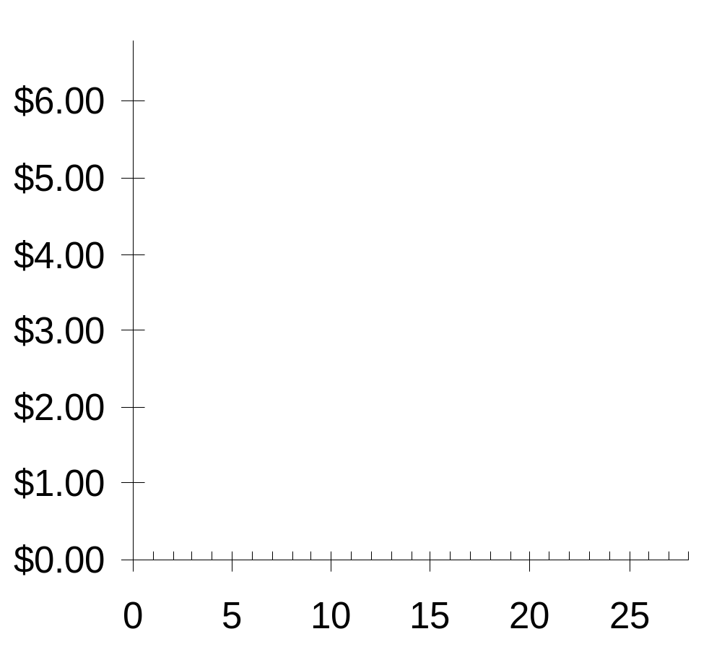
The Market Demand Curve for Lattes
0
P | Q^{d} (Market)
$0.00 | 24
1.00 | 21
2.00 | 18
3.00 | 15
4.00 | 12
5.00 | 9
6.00 | 6
P
Q
CHAPTER 4 THE MARKET FORCES OF SUPPLY AND DEMAND

Slide 9
Demand Curve Shifters
0
The demand curve shows how price affects quantity demanded, other things being equal.
These “other things” are non-price determinants of demand (i.e., things that determine buyers’ demand for a good, other than the good’s price).
Changes in them shift the D curve…
CHAPTER 4 THE MARKET FORCES OF SUPPLY AND DEMAND

Slide 10
Demand Curve Shifters: Number of buyers
0
An increase in the number of buyers causes
an increase in quantity demanded at each price, which shifts the demand curve to the right.
CHAPTER 4 THE MARKET FORCES OF SUPPLY AND DEMAND
Notes:
Income is the first demand shifter discussed in this chapter of the textbook. I chose to start with a different one (number of buyers), for the following reason:
In discussing the impact of changes in income on the demand curve, the textbook also introduces the concept of normal goods and inferior goods. Students may find it easier to learn about curve shifts if the presentation focuses solely on a curve shift (at least initially), without simultaneously introducing other concepts.
If you wish to present the demand shifters in the same order as they appear in the book, simply reorder the slides in this presentation.

Slide 11
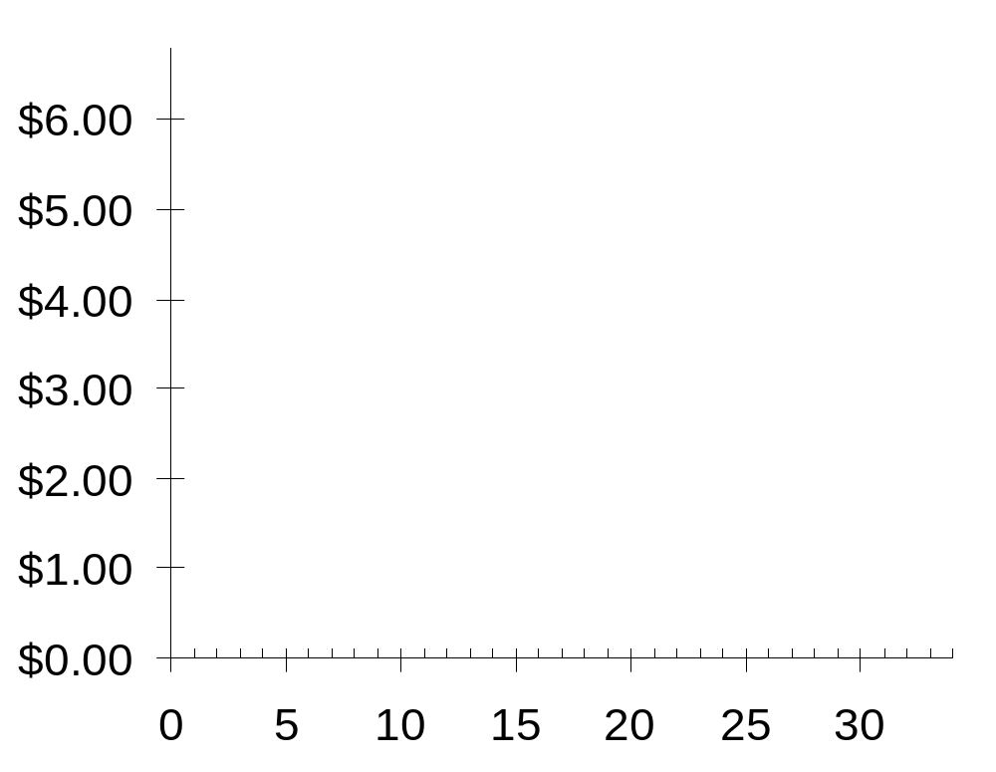
Demand Curve Shifters: Number of buyers
0
P
Suppose the number of buyers increases.
Then, at each price, quantity demanded will increase
(by 5 in this example).
Q
CHAPTER 4 THE MARKET FORCES OF SUPPLY AND DEMAND
Notes:
Beginning economics students often have trouble understanding the difference between a movement along the curve and a shift in the curve. Here, the animation has been carefully designed to help students see that a shift in the curve results from an increase in quantity at each price.
(A more realistic scenario would involve a non-parallel shift, where the horizontal distance of the shift would be greater for lower prices than higher ones. However, to remain consistent with the textbook, and to keep things simple, this slide shows a parallel shift.)

Slide 12
Demand Curve Shifters: income
0
Demand for a normal good is positively related to income.
  An increase in income causes increase
  in quantity demanded at each price, shifting the D curve to the right.
(Demand for an inferior good is negatively related to income. An increase in income shifts D curves for inferior goods to the left.)
CHAPTER 4 THE MARKET FORCES OF SUPPLY AND DEMAND

Slide 13
Demand Curve Shifters: Prices of related goods
0
Two goods are substitutes if
an increase in the price of one causes
an increase in demand for the other.
Example: pizza and hamburgers.
An increase in the price of pizza
increases demand for hamburgers,
shifting hamburger demand curve to the right.
Other examples: Coke and Pepsi,
laptops and desktop computers,
compact discs and music downloads
CHAPTER 4 THE MARKET FORCES OF SUPPLY AND DEMAND

Slide 14
Demand Curve Shifters: Prices of related goods
0
Two goods are complements if
an increase in the price of one causes
a fall in demand for the other.
Example: computers and software.
If price of computers rises, people buy fewer computers, and therefore less software.
Software demand curve shifts left.
Other examples: college tuition and textbooks,
bagels and cream cheese, eggs and bacon
CHAPTER 4 THE MARKET FORCES OF SUPPLY AND DEMAND

Slide 15
Demand Curve Shifters: Tastes
0
Anything that causes a shift in tastes toward a good will increase demand for that good
and shift its D curve to the right.
Example:
The Atkins diet became popular in the ’90s,
caused an increase in demand for eggs,
shifted the egg demand curve to the right.
Smart phones and gadgets
CHAPTER 4 THE MARKET FORCES OF SUPPLY AND DEMAND

Slide 16
Demand Curve Shifters: Expectations
0
Expectations affect consumers’ buying decisions.
Examples:
  If people expect their incomes to rise,
  their demand for meals at expensive restaurants may increase now.
  If the economy turns bad and people worry about their future job security, demand for new autos may fall now.
CHAPTER 4 THE MARKET FORCES OF SUPPLY AND DEMAND

Slide 17
Summary: Variables That Affect Demand
0
Variable A change in this variable…
Price …causes a movement
along the D curve
No. of buyers …shifts the D curve
Income …shifts the D curve
Price of
related goods …shifts the D curve
Tastes …shifts the D curve
Expectations …shifts the D curve
CHAPTER 4 THE MARKET FORCES OF SUPPLY AND DEMAND
Notes:
Students should notice that the only determinant of quantity demanded that causes a movement along the curve is price. Also notice: price is one of the variables measured along the axes of the graph.
Here’s a handy “rule of thumb” to help students remember whether the curve shifts: If the variable causing demand to change is measured on one of the axes, you move along the curve. If the variable that’s causing demand to change is NOT measured on either axis, then the curve shifts.
This rule of thumb works with all curves in economics that involve an X-Y relationship. (I.e., it works for the supply curve, the marginal cost curve, the IS and LM curves, among many others, but it doesn’t apply to curves drawn on time series graphs.)

Slide 18

A C T I V E L E A R N I N G 1:
Demand curve
Draw a demand curve for music downloads. What happens to it in each of the following scenarios? Why?
A. The price of iPods falls
B. The price of music downloads falls
C. The price of compact discs falls
Notes:
In each case, there are only three possible answers:
- the curve shifts to the right
- the curve shifts to the left
- the curve does not shift (though there may be a movement along the curve)

Slide 19
A C T I V E L E A R N I N G 1:
A. price of iPods falls
Music downloads and iPods are complements.
A fall in price of iPods shifts the demand curve for music downloads
to the right.
Price of music down-loads
P₁
D₁
D₂
Q₁
Q₂
Quantity of
music downloads
Notes:
Point out to your students that there are no numbers or units on either axis, and we are using “P₁” and “Q₁” to represent the initial price and quantity, rather than specific numerical values. Tell them that this is common, because in much economic analysis, the goal is only to see the direction of changes, not specific amounts. (Besides, if we put numbers on this graph, they’d just have been made up, so why bother?)
Also point out the following:
Notice that the price of music downloads is the same, but the quantity demanded is now higher. In fact, this is the nature of a shift in a curve: at any given price, the quantity is different than before.

Slide 20
A C T I V E L E A R N I N G 1:
B. price of music downloads falls
Price of music down-loads
The D curve
does not shift.
Move down along curve to a point with lower P, higher Q.
P₁
P₂
D₁
Q₁
Q₂
Quantity of
music downloads

Slide 21
A C T I V E L E A R N I N G 1:
C. price of CDs falls
Price of music down-loads
CDs and
music downloads are substitutes.
A fall in price of CDs shifts demand for music downloads
to the left.
P₁
D₂
D₁
Q₂
Q₁
Quantity of
music downloads

Slide 22
Supply
0
Supply comes from the behavior of sellers.
The quantity supplied of any good is the amount that sellers are willing and able to sell.
Law of supply: the claim that the quantity supplied of a good rises when the price of the good rises, other things equal
CHAPTER 4 THE MARKET FORCES OF SUPPLY AND DEMAND

Slide 23
The Supply Schedule
0
Supply schedule:
A table that shows the relationship between the price of a good and the quantity supplied.
Example:
Starbucks’ supply of lattes.
Price of lattes | Quantity of lattes supplied
$0.00 | 0
1.00 | 3
2.00 | 6
3.00 | 9
4.00 | 12
5.00 | 15
6.00 | 18
Notice that Starbucks’ supply schedule obeys the
Law of Supply.
CHAPTER 4 THE MARKET FORCES OF SUPPLY AND DEMAND

Slide 24
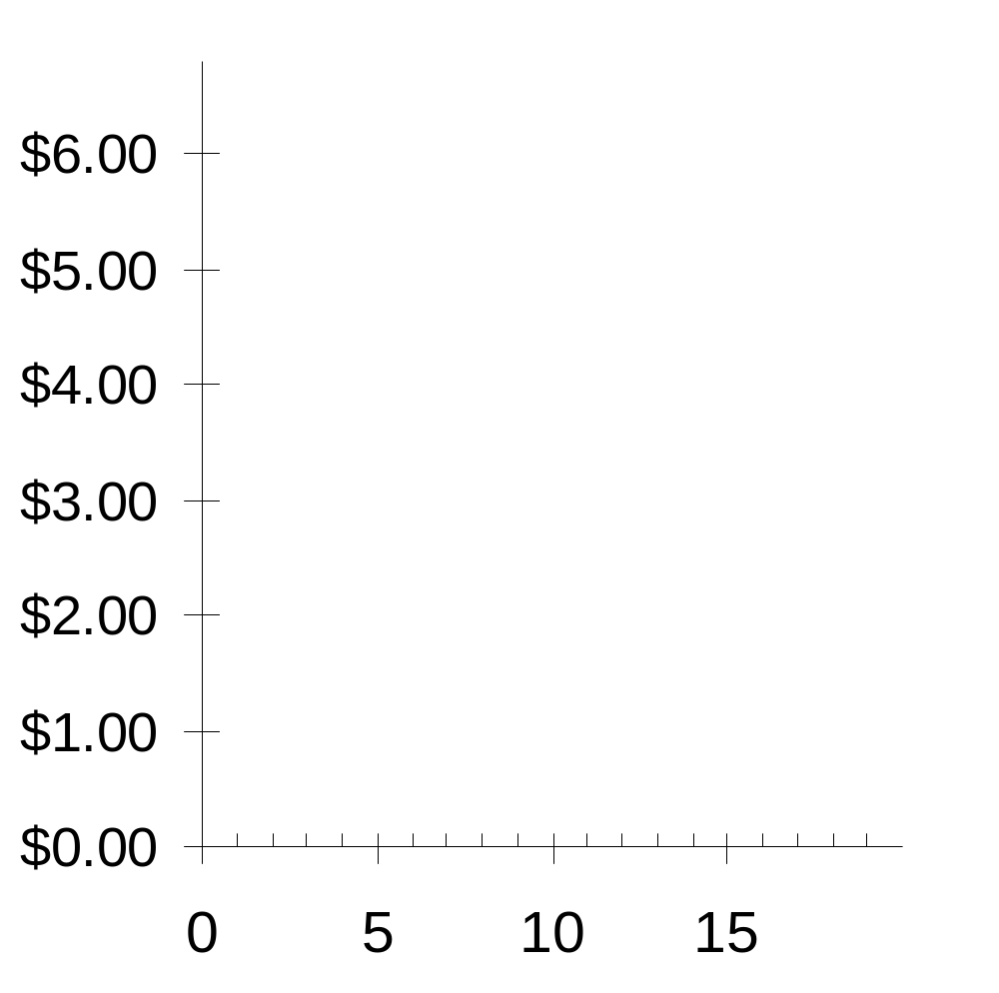
Starbucks’ Supply Schedule & Curve
0
Price of lattes | Quantity of lattes supplied
$0.00 | 0
1.00 | 3
2.00 | 6
3.00 | 9
4.00 | 12
5.00 | 15
6.00 | 18
P
Q
CHAPTER 4 THE MARKET FORCES OF SUPPLY AND DEMAND

Slide 25
Market Supply versus Individual Supply
0
The quantity supplied in the market is the sum of the quantities supplied by all sellers at each price.
Suppose Starbucks and Jitters are the only two sellers in this market. (Q^{s} = quantity supplied)
Price
Starbucks
Jitters
Market Q^{s}
$0.00
0
+
0
=
0
1.00
3
+
2
=
5
2.00
6
+
4
=
10
3.00
9
+
6
=
15
4.00
12
+
8
=
20
5.00
15
+
10
=
25
6.00
18
+
12
=
30
Notes:
Again, the assumption of only two sellers is a clear violation of perfect competition. However, it’s much easier for students to learn how the market supply curve relates to individual supplies in the two-firm case.

Slide 26
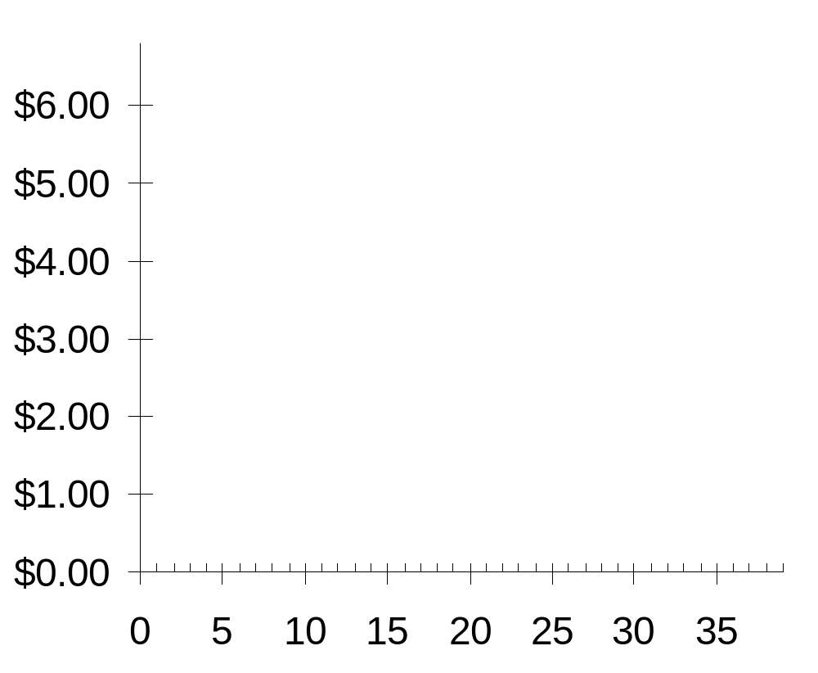
The Market Supply Curve
0
P | Q^{S} (Market)
$0.00 | 0
1.00 | 5
2.00 | 10
3.00 | 15
4.00 | 20
5.00 | 25
6.00 | 30
P
Q
CHAPTER 4 THE MARKET FORCES OF SUPPLY AND DEMAND

Slide 27
Supply Curve Shifters
0
The supply curve shows how price affects quantity supplied, other things being equal.
These “other things” are non-price determinants of supply.
Changes in them shift the S curve…
CHAPTER 4 THE MARKET FORCES OF SUPPLY AND DEMAND
Notes:
“Non-price determinants of supply” simply means the things – other than the price of a good – that determine sellers’ supply of the good.

Slide 28
Supply Curve Shifters: Input prices
0
Examples of input prices:
wages, prices of raw materials.
A fall in input prices makes production
more profitable at each output price,
so firms supply a larger quantity at each price,
and the S curve shifts to the right.
CHAPTER 4 THE MARKET FORCES OF SUPPLY AND DEMAND
Notes:
In the second bullet point, “output price” just means the price of the good that firms are producing and selling. I have used “output price” here to distinguish it from “input prices.”

Slide 29
Supply Curve Shifters: Input prices
0
P
Suppose the price of milk falls.
At each price, the quantity of
Lattes supplied
will increase
(by 5 in this example).
Q
CHAPTER 4 THE MARKET FORCES OF SUPPLY AND DEMAND
Notes:
Again, the animation here is carefully designed to help make clear that a shift in the supply curve means that there is a change in the quantity supplied at each possible price. If it seems tedious, you can turn it off. In any case, be assured that, by the end of this chapter, the animation of curve shifts will be streamlined and simplified.

Slide 30
Supply Curve Shifters: Technology
0
Technology determines how much inputs are required to produce a unit of output.
A cost-saving technological improvement has same effect as a fall in input prices,
shifts the S curve to the right.
CHAPTER 4 THE MARKET FORCES OF SUPPLY AND DEMAND

Slide 31
Supply Curve Shifters: Number of sellers
0
An increase in the number of sellers increases the quantity supplied at each price,
shifts the S curve to the right.
CHAPTER 4 THE MARKET FORCES OF SUPPLY AND DEMAND

Slide 32
Supply Curve Shifters: Expectations
0
Suppose a firm expects the price of the good it sells to rise in the future.
The firm may reduce supply now, to save some of its inventory to sell later at the higher price.
This would shift the S curve leftward.
CHAPTER 4 THE MARKET FORCES OF SUPPLY AND DEMAND
Notes:
You might consider mentioning to students that this is just one example of how expectations might affect the supply curve; a change in expectations will not always shift the supply curve to the left.

Slide 33
Summary: Variables That Affect Supply
0
Variable A change in this variable…
Price …causes a movement
along the S curve
Input prices …shifts the S curve
Technology …shifts the S curve
No. of sellers …shifts the S curve
Expectations …shifts the S curve
CHAPTER 4 THE MARKET FORCES OF SUPPLY AND DEMAND
Notes:
Again, the price is the only determinant of quantity supplied that causes a movement along the curve. A change in any of the other determinants causes the supply curve to shift.

Slide 34

A C T I V E L E A R N I N G 2:
Supply curve
0
Draw a supply curve for tax
return preparation software.
What happens to it in each
of the following scenarios?
  A. Retailers cut the price of
  the software.
  B. A technological advance
  allows the software to be
  produced at lower cost.
  C. Professional tax return preparers raise the price of the services they provide.
Notes:
Examples of tax return preparation software include TurboTax by Quicken and TaxCut by H&R Block.

Slide 35
A C T I V E L E A R N I N G 2:
A. fall in price of tax return software
Price of tax return software
The S curve
does not shift.
Move down
along the curve
to a lower P
and lower Q.
S₁
P₁
P₂
Q₂
Q₁
Quantity of tax return software

Slide 36
A C T I V E L E A R N I N G 2:
B. fall in cost of producing the software
Price of tax return software
The S curve shifts to the right:
at each price,
Q increases.
S₁
S₂
P₁
Q₁
Q₂
Quantity of tax return software

Slide 37
A C T I V E L E A R N I N G 2:
C. professional preparers raise their price
Price of tax return software
S₁
This shifts the demand curve for tax preparation software, not the supply curve.
Quantity of tax return software

Slide 38
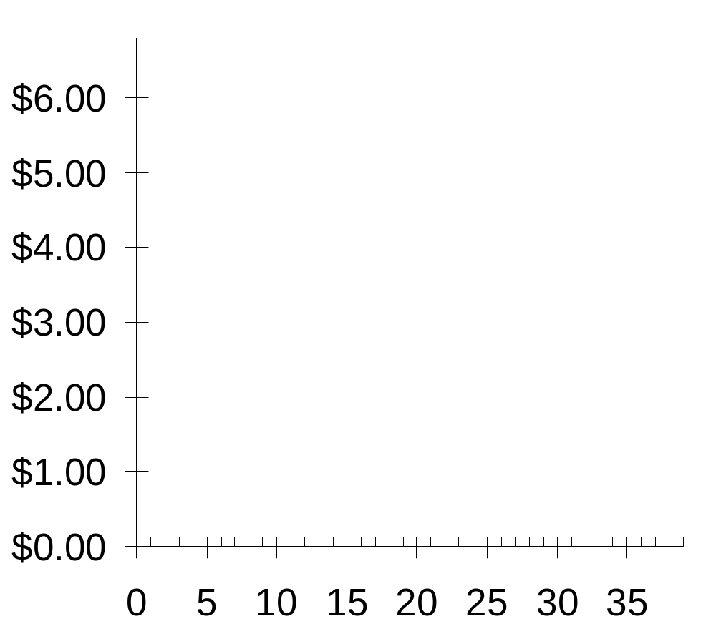
Supply and Demand Together
0
P
Equilibrium:
P has reached
the level where
quantity supplied equals
quantity demanded
D
S
Q
CHAPTER 4 THE MARKET FORCES OF SUPPLY AND DEMAND
Notes:
We now return to the latte example to illustrate the concepts of equilibrium, shortage and surplus.

Slide 39
Equilibrium price:
0
The price that equates quantity supplied with quantity demanded
P
D
S
P | Q^{D} | Q^{S}
$0 | 24 | 0
1 | 21 | 5
2 | 18 | 10
3 | 15 | 15
4 | 12 | 20
5 | 9 | 25
6 | 6 | 30
Q
CHAPTER 4 THE MARKET FORCES OF SUPPLY AND DEMAND

Slide 40
Equilibrium quantity:
0
The quantity supplied and quantity demanded at the equilibrium price
P
D
S
P | Q^{D} | Q^{S}
$0 | 24 | 0
1 | 21 | 5
2 | 18 | 10
3 | 15 | 15
4 | 12 | 20
5 | 9 | 25
6 | 6 | 30
Q
CHAPTER 4 THE MARKET FORCES OF SUPPLY AND DEMAND

Slide 41
Surplus:
0
when quantity supplied is greater than quantity demanded
P
D
Surplus
S
Example:
If P = $5,
then
Q^{D} = 9 lattes
and
Q^{S} = 25 lattes
resulting in a surplus of 16 lattes
Q
CHAPTER 4 THE MARKET FORCES OF SUPPLY AND DEMAND

Slide 42
Surplus:
0
when quantity supplied is greater than quantity demanded
P
Facing a surplus,
sellers try to increase sales by cutting the price.
D
Surplus
S
This causes
Q^{D} to rise
and Q^{S} to fall…
…which reduces the surplus.
Q
CHAPTER 4 THE MARKET FORCES OF SUPPLY AND DEMAND

Slide 43
Surplus:
0
when quantity supplied is greater than quantity demanded
P
Facing a surplus,
sellers try to increase sales by cutting the price.
D
Surplus
S
Falling prices cause
Q^{D} to rise and Q^{S} to fall.
Prices continue to fall until market reaches equilibrium.
Q
CHAPTER 4 THE MARKET FORCES OF SUPPLY AND DEMAND

Slide 44
Shortage:
0
when quantity demanded is greater than quantity supplied
P
D
S
Example:
If P = $1,
then
Q^{D} = 21 lattes
and
Q^{S} = 5 lattes
resulting in a
shortage of 16 lattes
Shortage
Q
CHAPTER 4 THE MARKET FORCES OF SUPPLY AND DEMAND

Slide 45

Shortage:
0
when quantity demanded is greater than quantity supplied
P
Facing a shortage,
sellers raise the price,
D
S
causing Q^{D} to fall
and Q^{S} to rise,
…which reduces the shortage.
Shortage
Q
CHAPTER 4 THE MARKET FORCES OF SUPPLY AND DEMAND

Slide 46
Shortage:
0
when quantity demanded is greater than quantity supplied
P
Facing a shortage,
sellers raise the price,
D
S
causing Q^{D} to fall
and Q^{S} to rise.
Prices continue to rise until market reaches equilibrium.
Shortage
Q
CHAPTER 4 THE MARKET FORCES OF SUPPLY AND DEMAND

Slide 47
Three Steps to Analyzing Changes in Eq’m
  1. Decide whether event shifts S curve,
  D curve, or both.
  2. Decide in which direction curve shifts.
  3. Use supply-demand diagram to see
  how the shift changes eq’m P and Q.
To determine the effects of any event,
CHAPTER 4 THE MARKET FORCES OF SUPPLY AND DEMAND
Notes:
Step one requires knowing all of the things that can shift D and S – the non-price determinants of demand and of supply.

Slide 48
EXAMPLE: The Market for Hybrid Cars
P
price of hybrid cars
S₁
P₁
D₁
Q
Q₁
quantity of
hybrid cars
CHAPTER 4 THE MARKET FORCES OF SUPPLY AND DEMAND
Notes:
Examples of hybrid cars that exist as of August 2005:
Toyota Prius, Honda Insight, plus hybrid versions of the Ford Escape, Honda Accord, Toyota Highlander, and the Lexus RX400h SUV.

Slide 49
EXAMPLE 1: A Change in Demand
EVENT TO BE
ANALYZED:
Increase in price of gas.
P
S₁
STEP 1:
D curve shifts
because price of gas affects demand for hybrids.
S curve does not shift, because price of gas does not affect cost of producing hybrids.
P₂
STEP 2:
D shifts right
because high gas price makes hybrids more attractive relative to other cars.
P₁
STEP 3:
The shift causes an increase in price
and quantity of hybrid cars.
D₁
D₂
Q
Q₁
Q₂
CHAPTER 4 THE MARKET FORCES OF SUPPLY AND DEMAND

Slide 50
EXAMPLE 1: A Change in Demand
Notice:
When P rises, producers supply
a larger quantity
of hybrids, even though the S curve has not shifted.
P
S₁
P₂
P₁
Always be careful to distinguish b/w a shift in a curve and a movement along the curve.
D₁
D₂
Q
Q₁
Q₂
CHAPTER 4 THE MARKET FORCES OF SUPPLY AND DEMAND

Slide 51
Terms for Shift vs. Movement Along Curve
Change in supply: a shift in the S curve
  occurs when a non-price determinant of supply changes (like technology or costs)
Change in the quantity supplied:
a movement along a fixed S curve
  occurs when P changes
Change in demand: a shift in the D curve
  occurs when a non-price determinant of demand changes (like income or # of buyers)
Change in the quantity demanded:
a movement along a fixed D curve
  occurs when P changes
Notes:
“Supply” refers to the position of the supply curve, while “quantity supplied” refers to the specific amount that producers are willing and able to sell.
Similarly, “demand” refers to the position of the demand curve, while “quantity demanded” refers to the specific amount that consumers are willing and able to buy.
If you’d like to be a rebel, delete this slide and all references to the jargon it contains, and just use the terms “movement along a curve” and “shift in a curve.” Note, however, that this is not the official recommendation of Thomson/South-Western or Dr. Mankiw.
If you’d like to cover this slide but make it move more quickly, delete the text next to each little blue bullet point, and give the information to your students verbally (or rely on them to read it in the textbook).

Slide 52
EXAMPLE 2: A Change in Supply
EVENT: New technology reduces cost of producing hybrid cars.
P
S₁
S₂
STEP 1:
S curve shifts
because event affects cost of production.
D curve does not shift, because production technology is not one of the factors that affect demand.
STEP 2:
S shifts right
because event reduces cost,
makes production more profitable at any given price.
P₁
P₂
STEP 3:
The shift causes price to fall
and quantity to rise.
D₁
Q
Q₁
Q₂
CHAPTER 4 THE MARKET FORCES OF SUPPLY AND DEMAND

Slide 53
EXAMPLE 3: A Change in Both Supply and Demand
EVENTS:
price of gas rises AND
new technology reduces production costs
P
S₁
S₂
STEP 1:
Both curves shift.
P₂
P₁
STEP 2:
Both shift to the right.
STEP 3:
Q rises, but effect
on P is ambiguous:
If demand increases more than supply, P rises.
D₁
D₂
Q
Q₁
Q₂
CHAPTER 4 THE MARKET FORCES OF SUPPLY AND DEMAND

Slide 54
EXAMPLE 3: A Change in Both Supply and Demand
EVENTS:
price of gas rises AND
new technology reduces production costs
P
S₁
S₂
STEP 3, cont.
P₁
But if supply increases more than demand,
P falls.
P₂
D₁
D₂
Q
Q₁
Q₂
CHAPTER 4 THE MARKET FORCES OF SUPPLY AND DEMAND

Slide 55
A C T I V E L E A R N I N G 3:
Changes in supply and demand
Use the three-step method to analyze the effects of each event on the equilibrium price and quantity of music downloads.
  Event A: A fall in the price of compact discs
  Event B: Sellers of music downloads negotiate a reduction in the royalties they must pay for each song they sell.
  Event C: Events A and B both occur.
Notes:
In case it’s not clear: The royalties that sellers must pay the artists are part of the sellers’ “costs of production.” Typically, this royalty is a fixed amount each time one of the artist’s songs is downloaded. Event B is a reduction in this cost.

Slide 56
A C T I V E L E A R N I N G 3:
A. fall in price of CDs
The market for music downloads
P
S₁
STEPS
1. D curve shifts
P₁
2. D shifts left
P₂
3. P and Q both fall.
D₂
D₁
Q
Q₂
Q₁
Notes:
This is an extension of Active Learning exercise 1C, where we saw that a fall in the price of compact discs would cause a fall in demand for music downloads, because the two goods are substitutes.

Slide 57
A C T I V E L E A R N I N G 3:
B. fall in cost of royalties
The market for music downloads
P
S₁
S₂
STEPS
1. S curve shifts
P₁
(royalties are part of sellers’ costs)
2. S shifts right
P₂
3. P falls,
Q rises.
D₁
Q
Q₁
Q₂
Notes:
NOTE: Don’t worry that the text on this slide looks garbled in “Normal view” (i.e. edit mode). It works fine in “Slide Show” (i.e. presentation mode).
Event B: Sellers of music downloads negotiate a reduction in the royalties they must pay for each song they sell. This event causes a fall in “costs of production” for sellers of music downloads. Hence, the S curve shifts to the right.

Slide 58
A C T I V E L E A R N I N G 3:
C. fall in price of CDs
AND fall in cost of royalties
STEPS
1. Both curves shift (see parts A & B).
2. D shifts left, S shifts right.
3. P unambiguously falls.
Effect on Q is ambiguous:
The fall in demand reduces Q,
the increase in supply increases Q.
Notes:
It’s not necessary to draw a graph here. The answers to steps 1 and 2 should be clear from parts A and B. The answer to step 3 is a combination of the results from A and B.

Slide 59
CONCLUSION:
How Prices Allocate Resources
One of the Ten Principles from Chapter 1: Markets are usually a good way
to organize economic activity.
In market economies, prices adjust to balance supply and demand. These equilibrium prices are the signals that guide economic decisions and thereby allocate scarce resources.
CHAPTER 4 THE MARKET FORCES OF SUPPLY AND DEMAND
Notes:
In the textbook, the conclusion of this chapter offers some very nice elaboration on the second bullet point.

